Slide 1
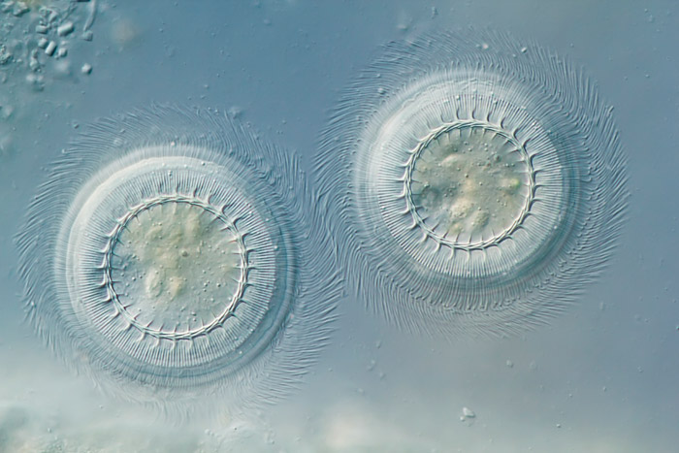
Phase contrast and DIC
Ryan McGorty, UCSF
2013 March 25
Gerd A. Guenther
2011 Honorable Mention
Nikon Small World photomicrograhy competition
Image of a freshwater ciliate.

Slide 2
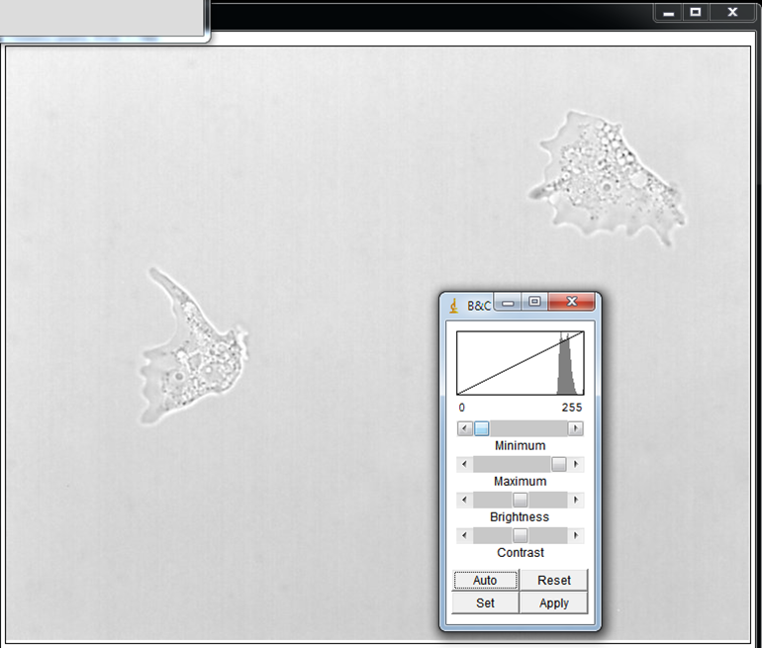
Enhancing contrast: ex post facto

Slide 3
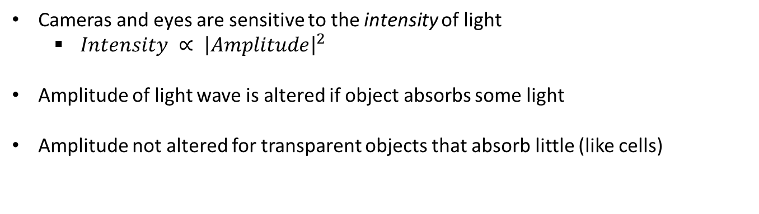
Why cells have poor contrast?
Cameras and eyes are sensitive to the intensity of light
$Intensity ∝ {\left|Amplitude\right|}^{2}$
Amplitude of light wave is altered if object absorbs some light
Amplitude not altered for transparent objects that absorb little (like cells)

Slide 4
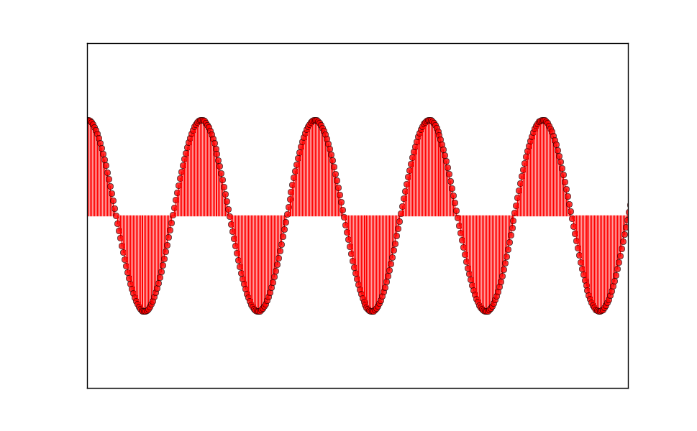
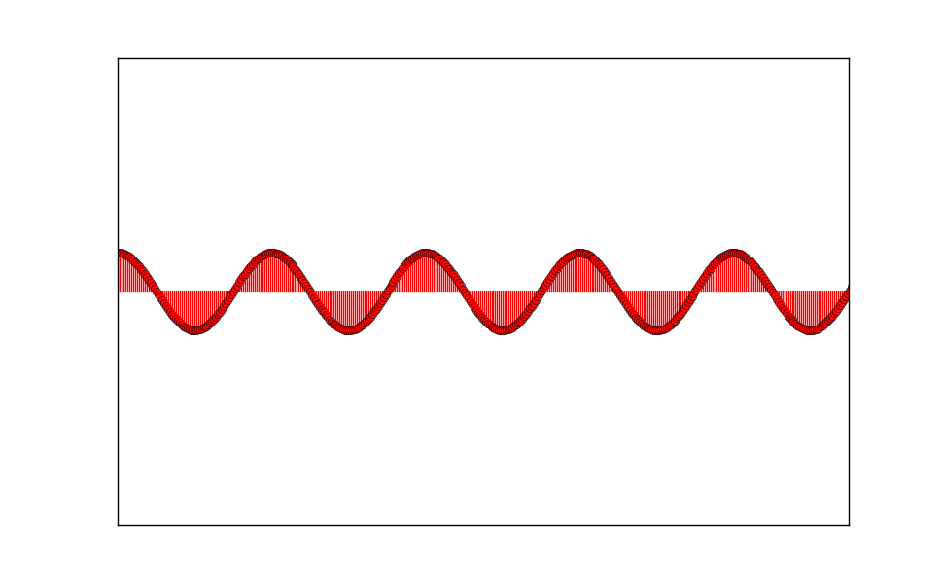
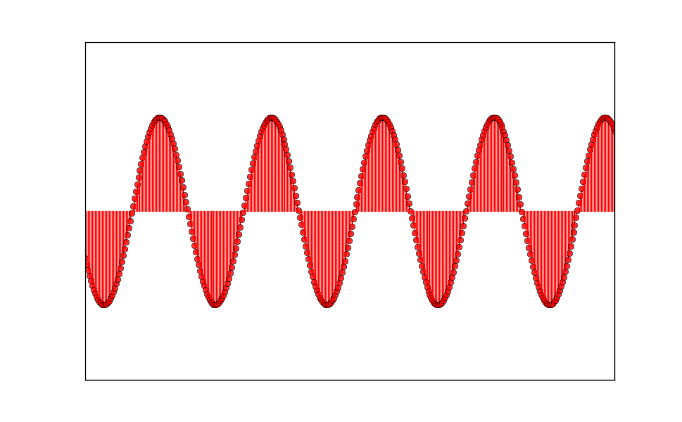
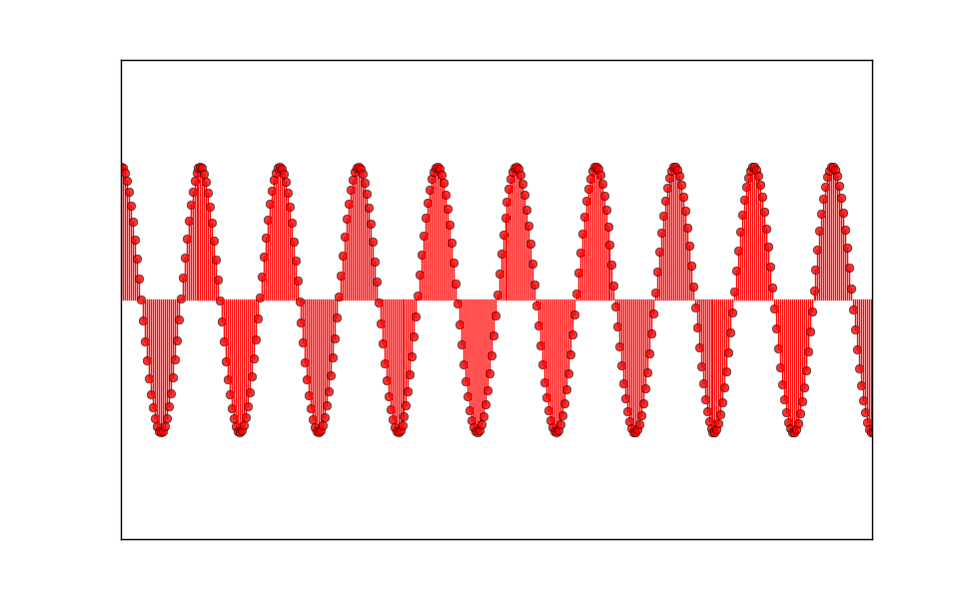
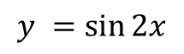
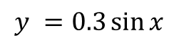
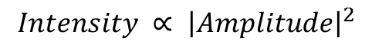
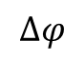
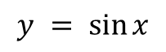
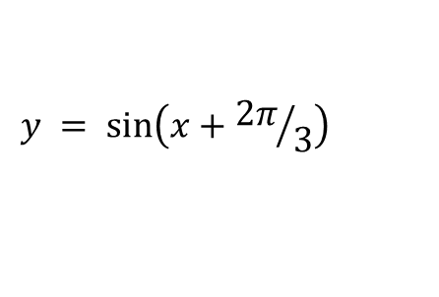
Properties of light
$$y = \sin{x}$$
$$y =0.3\sin{x}$$
Intensity difference
$$Intensity ∝ {\left|Amplitude\right|}^{2}$$
$$y = \sin\left(x+{2π}/3\right)$$
$$y =\sin{2x}$$
Color difference
$$∆φ$$

Slide 5
Ways to achieve high contrast
Contrast depends on instrument and sample.
Exogenous:
Staining
Fluorescent labels
Scattering labels
Beads, nanoparticles
Intrinsic:
Absorption
Scattering
Phase shift
For cells and thin tissue samples phase shift is all we have to work with.

Slide 6
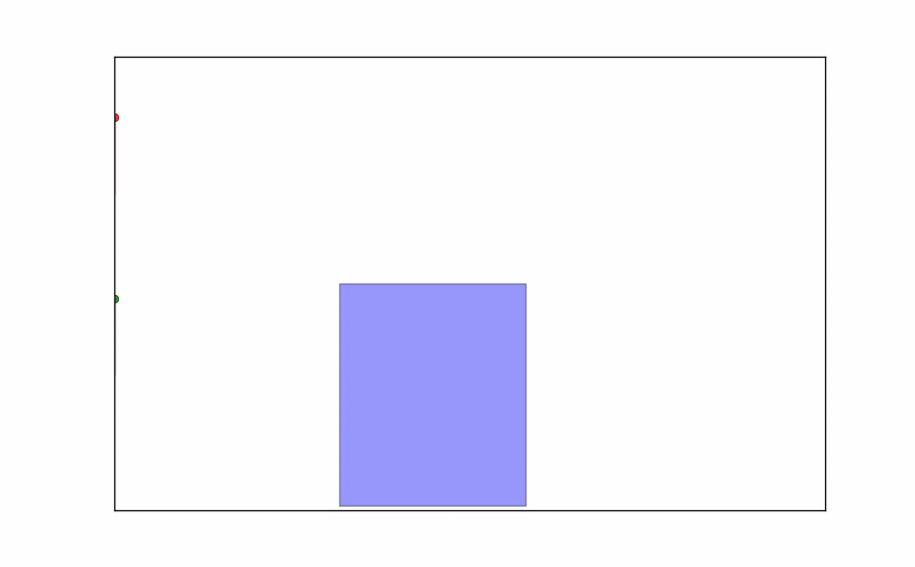
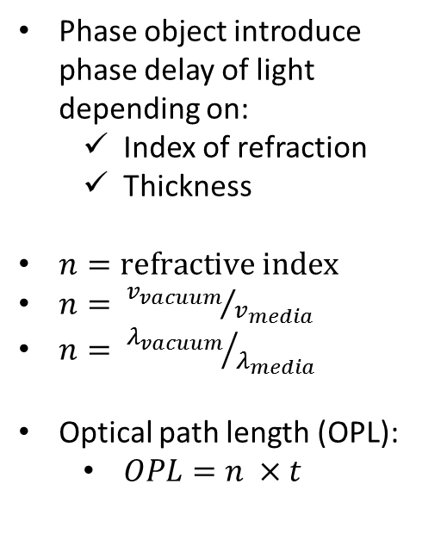
Phase Objects
Phase object introduce phase delay of light depending on:
Index of refraction
Thickness
$n=refractive index$
$n= {v_{vacuum}}/{v_{media}}$
$n= {λ_{vacuum}}/{λ_{media}}$
Optical path length (OPL):
$OPL=n ×t$

Slide 7
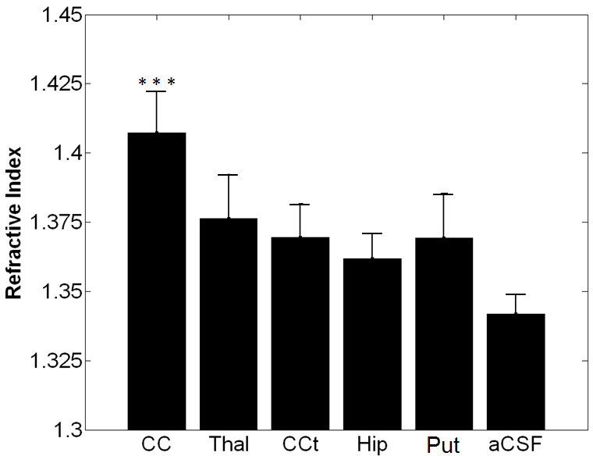
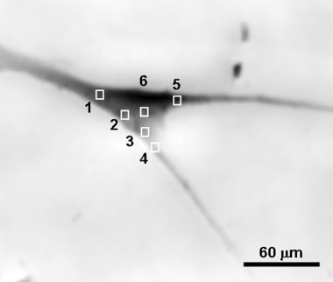
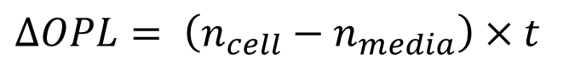
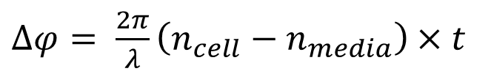
Refractive indices of biological samples
From Xie et al., 2012. Optics Express.
1.361
1.360
From Delbridge, L.M.D et al. 2005. Cytometry Part A.
1.364
1.357
1.361
1.359
Various regions of the brain
Image of smooth muscle cell
$∆OPL= \left(n_{cell}−n_{media}\right)×t$
$∆φ= \frac{2π}{λ}\left(n_{cell}−n_{media}\right)×t$
$$∆OPL= \left(1.360−1.335\right)×5 μm=0.125 μm$$
$∆φ= \frac{2π}{0.5 μm}\left(1.360−1.335\right)×5 μm=1.57 rad=90°$

Slide 8
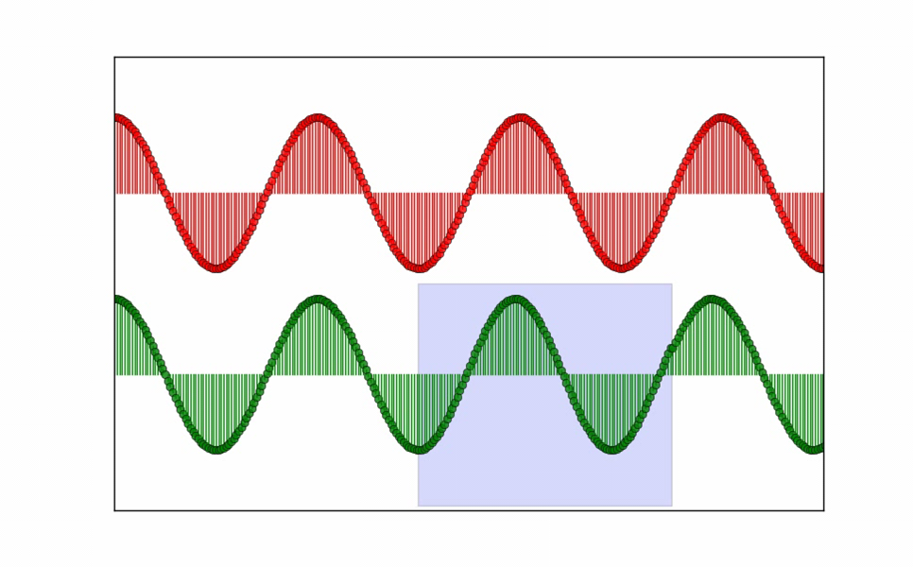
Phase difference between two waves depends on the optical path difference (OPD).
Optical path difference = difference in refractive index × distance

Slide 9
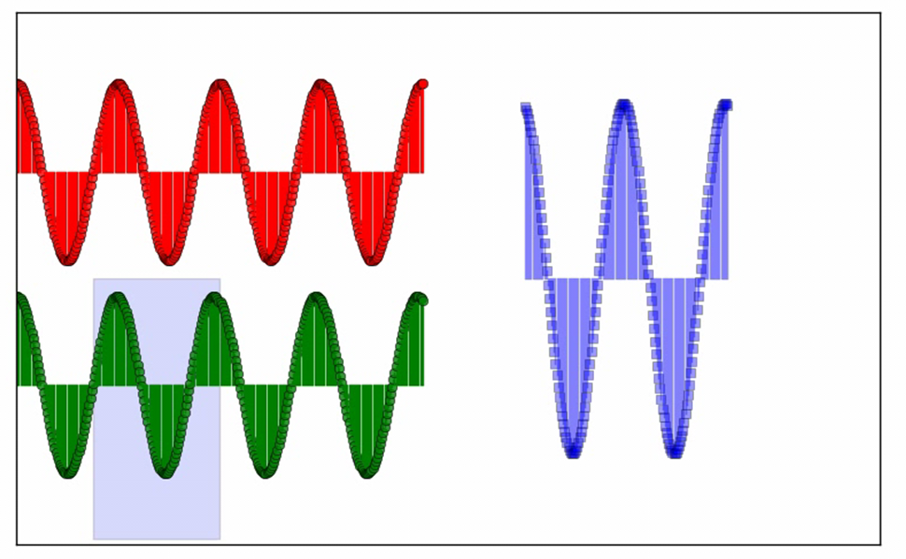
How to observe phase changes?
Must convert difference in phase to amplitude.
Solution: sum shifted wave with some reference

Slide 10
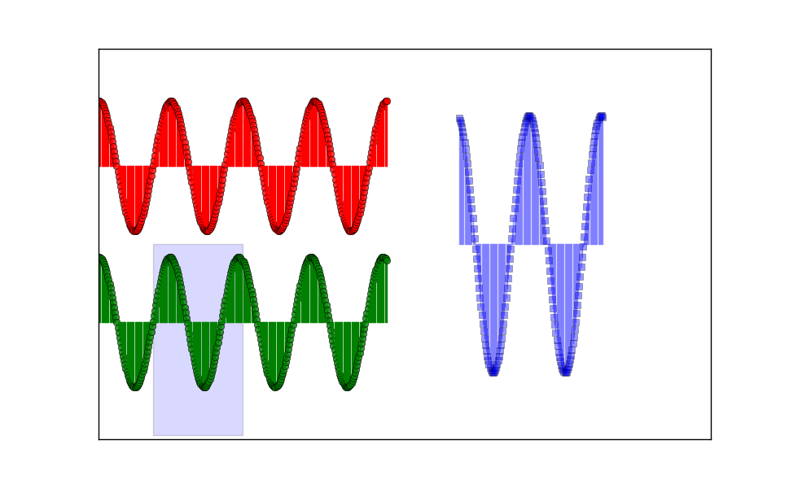
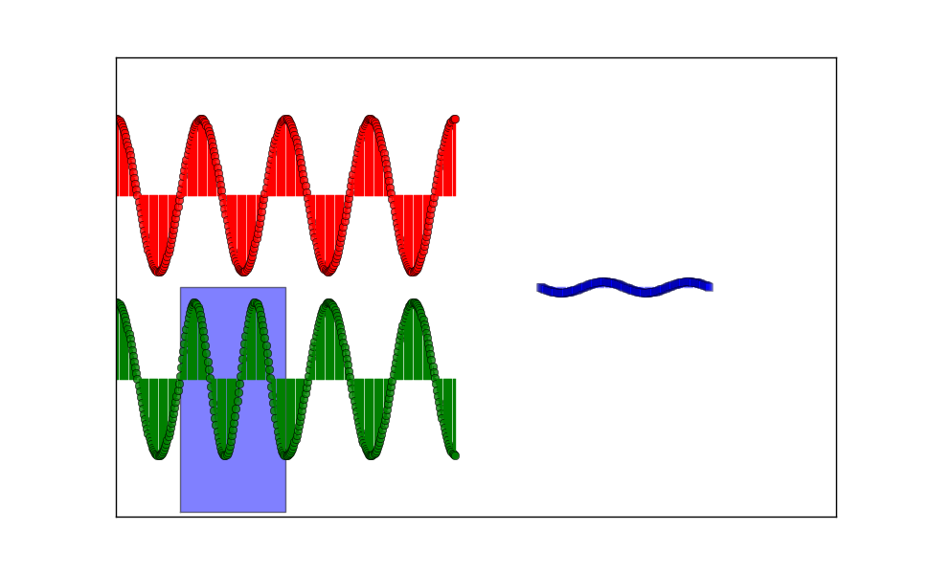
Interference
Waves that are in phase add constructively.
Waves that are 180° or λ/2 out of phase add destructively.

Slide 11
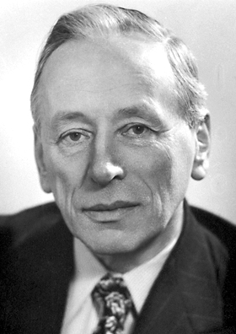
Phase contrast microscopy
Devised phase contrast microscopy in 1930s. Received Nobel Prize 1953.
“…it is common knowledge that in all interference phenomena differences of phase are all-important. Why then had phases never been considered before … in the microscope?”
Phases difficult to see
Must convert phase differences to intensity differences
Phases difficult to define
Only relative phase matters
Frits Zernike

Slide 12
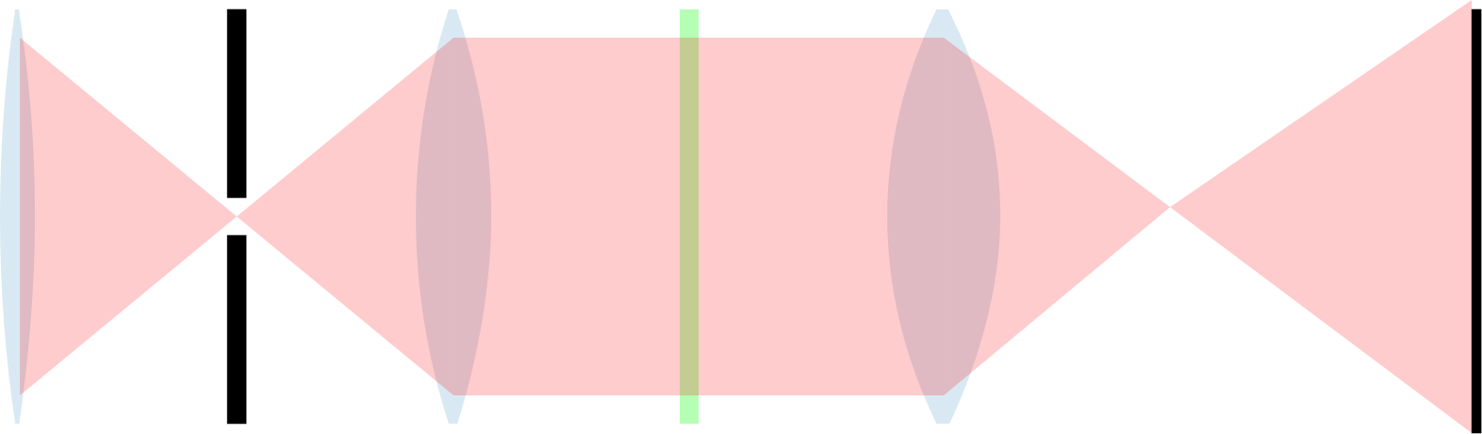
Light path for bright-field microscopy
No Sample
Uniform illumination at the sample plane
At objective’s back focal plane, light occupies small spot
Uniform intensity at the image plane
Condenser
Sample plane
Objective
Back focal plane
Light source
Image plane

Slide 13
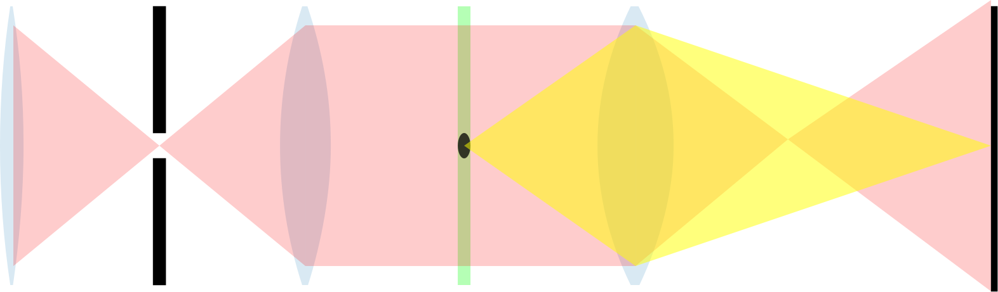
Light path for bright-field microscopy
With Sample
Objective captures light from sample
Light from point in sample focused to point at the image plane
Light from sample occupies larger area in back focal plane
Condenser
Sample plane
Objective
Back focal plane
Light source
Image plane

Slide 14
Light path for bright-field microscopy
With Sample
Objective captures light from sample
Light from point in sample focused to point at the image plane
Light from sample occupies larger area in back focal plane
Light source
Contrast depends on the intensity difference between here and here

Slide 15
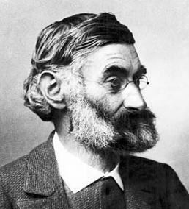
The microscope image is the interference effect of a diffraction phenomenon.
-Ernst Abbe
Interference at image plane between
surround or undiffracted light and
diffracted light.
Contrast depends on intensity of surround light and intensity of surround + diffracted (= particle) light.
For phase objects: diffracted light is 90° out of phase with surround light
Light source
Contrast depends on the intensity difference between here and here

Slide 16
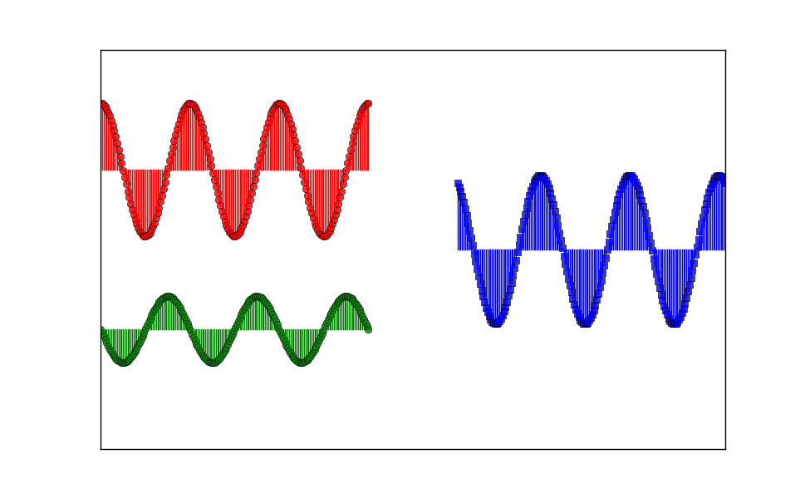
Superposition of two waves, 90° phase difference
Surround
Particle
Diffracted

Slide 17
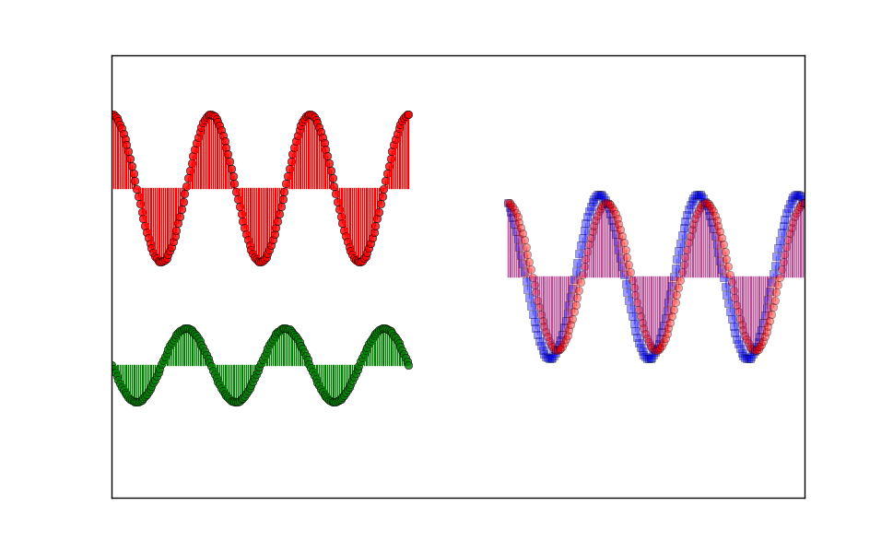
Superposition of two waves, 90° phase difference
Surround
Surround
Particle
Diffracted

Slide 18
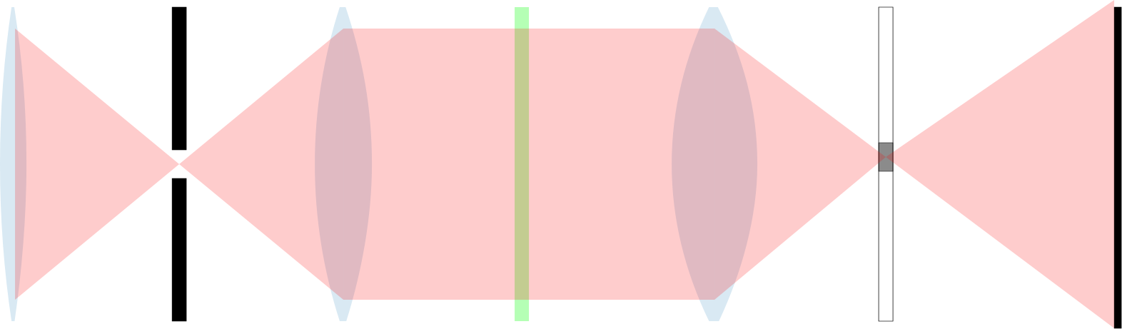
Phase contrast microscopy
The microscope image is the interference effect of a diffraction phenomenon.
-Ernst Abbe
To achieve larger amplitude difference between surround and particle wave: adjust phase difference between surround and diffracted light.
Phase plate
Condenser
Sample plane
Objective
Back focal plane
Light source
Image plane

Slide 19
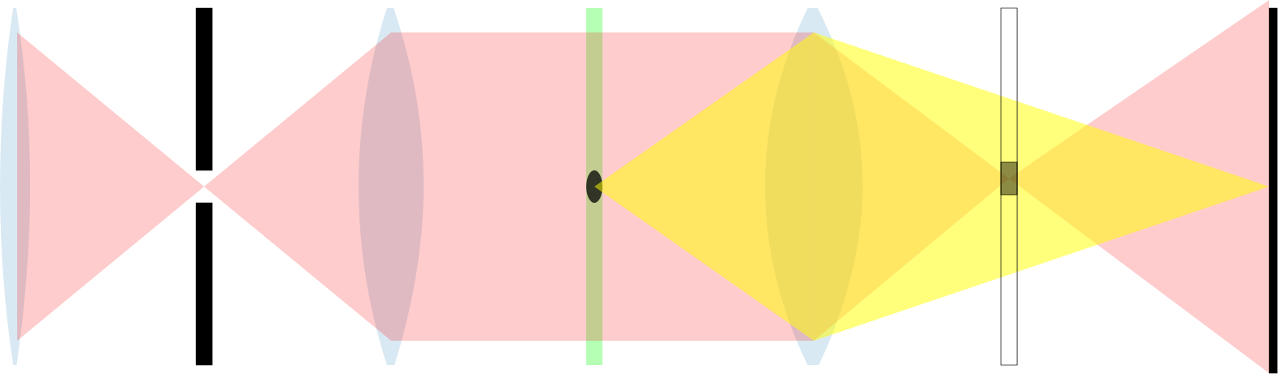
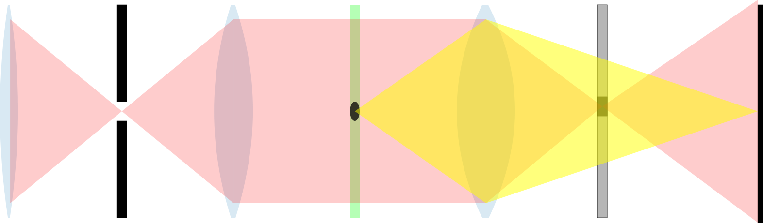
Phase contrast microscopy
The microscope image is the interference effect of a diffraction phenomenon.
-Ernst Abbe
Phase plate shifts phase of surround light but has little effect on diffracted light.
Phase plate
Condenser
Sample plane
Objective
Back focal plane
Light source
Image plane

Slide 20
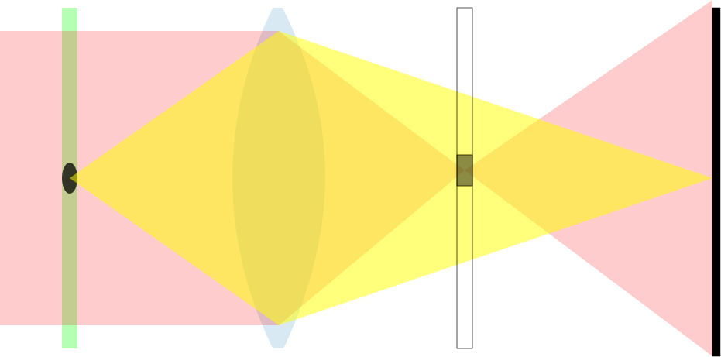
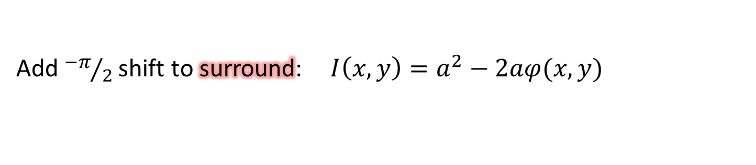

Phase contrast microscopy
… with equations
Field at the image plane: $U\left(x,y\right)=U_{0}+U_{1}(x,y)$
Add $π/2$ shift to surround: $I\left(x,y\right)=a^{2}+2aφ(x,y)$
Add${−π}/2$shift to surround: $I\left(x,y\right)=a^{2}−2aφ(x,y)$

Slide 21
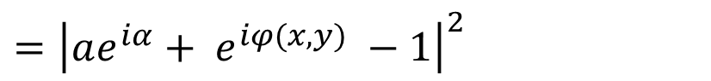
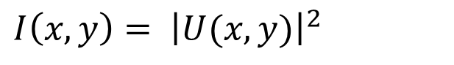
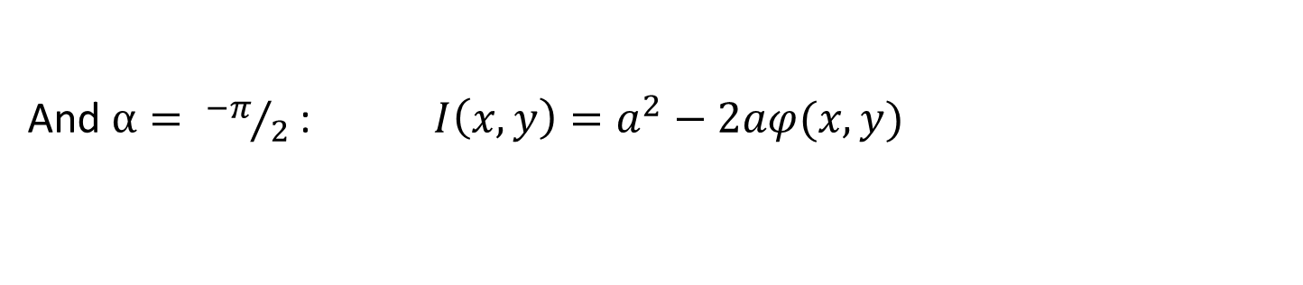
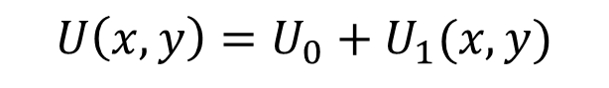
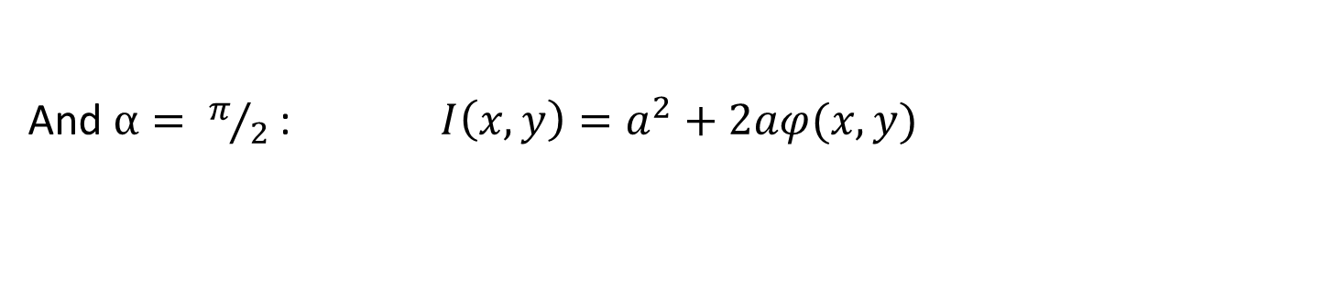
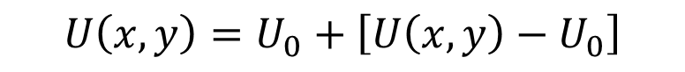

Phase contrast microscopy
… with equations
$U\left(x,y\right)=e^{iφ(x,y)}$ (Assuming a phase only sample. Notice $I= {\left|U\right|}^{2}= e^{−iφ(x,y)}e^{iφ\left(x,y\right)}=1)$
$$U\left(x,y\right)=U_{0}+U_{1}(x,y)$$
$$U_{1}\left(x,y\right)=U\left(x,y\right)−U_{0}$$
$$U\left(x,y\right)=U_{0}+\left[U\left(x,y\right)−U_{0}\right]$$
Introduce phase plate: $U_{0}→U_{0}ae^{iα}$
$$I\left(x,y\right)= {\left|U(x,y)\right|}^{2}$$
$$={\left|ae^{iα}+ e^{iφ(x,y)} −1\right|}^{2}$$
$$I\left(x,y\right)=a^{2}+2\left[1 −a\cos{α − \cos{φ}+a\cos{(α+φ)}}\right]$$
Assuming $φ$is small: $I\left(x,y\right)=a^{2}+2aφ(x,y)\sin{α}$
And $α= π/2$: $I\left(x,y\right)=a^{2}+2aφ(x,y)$
And $α= {−π}/2$: $I\left(x,y\right)=a^{2}−2aφ(x,y)$

Slide 22
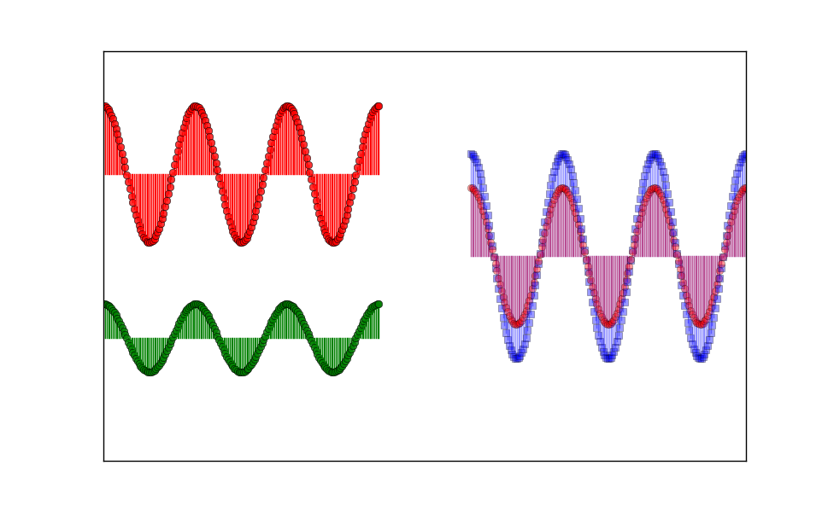
Surround wave 90° out of phase with diffracted wave.
Surround wave
Particle wave
Surround wave in phase with diffracted wave.

Slide 23
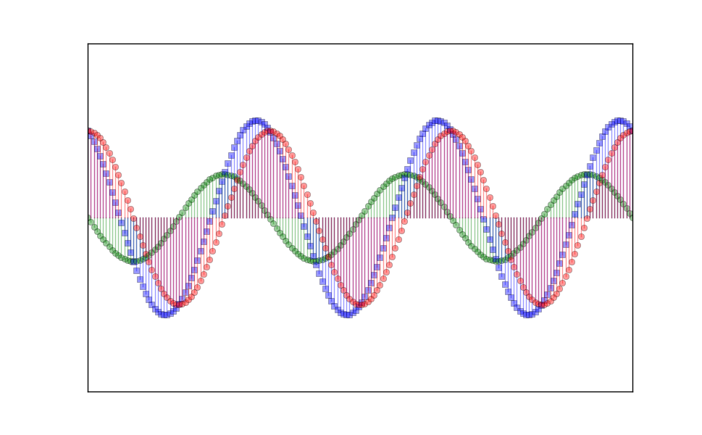
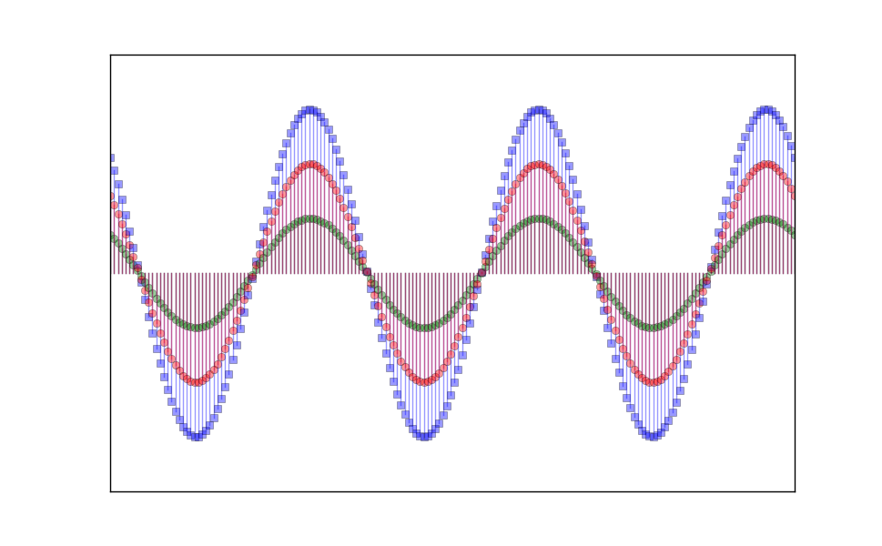
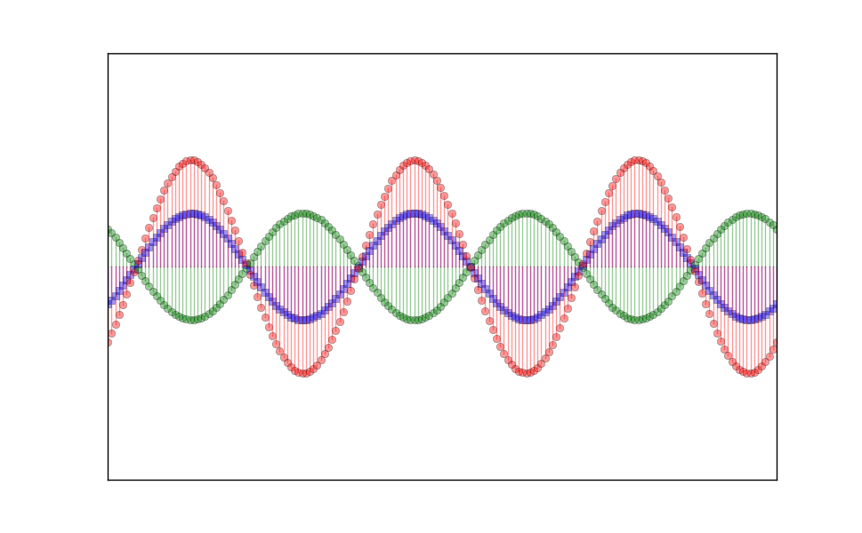
Vector’s length gives its amplitude. Vector’s angle gives its phase.
Particle wave
Diffracted wave
Surround wave
Negative
Phase Contrast
Surround wave is rotated by 90° but diffracted wave is untouched.
Positive
Phase Contrast

Slide 24
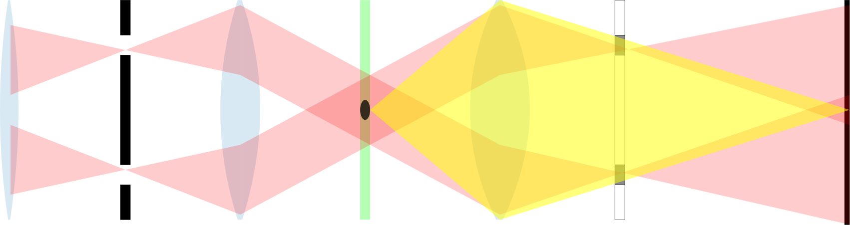
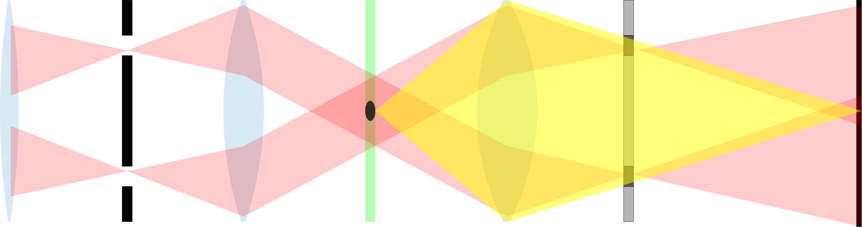
Condenser annulus and phase ring
Annulus allows more of the condenser aperture to be used

Slide 25
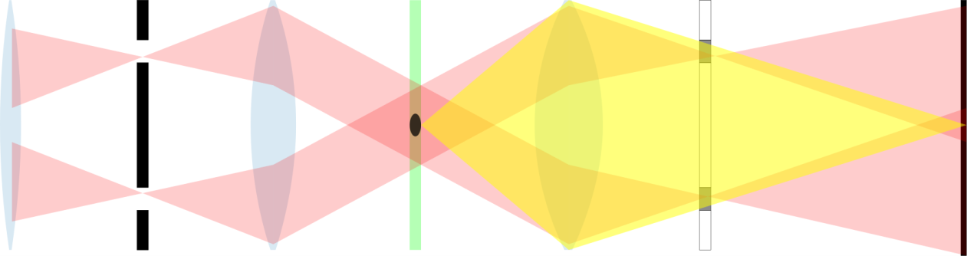
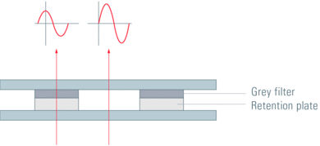
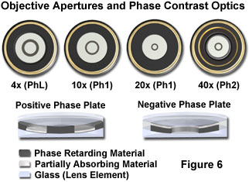
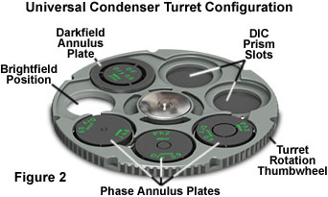
Phase Contrast Plates
Annulus plate
Phase plate
Condenser
Objective

Slide 26



How to get the best contrast?
$$γ= \frac{I_{max}− I_{min}}{I_{max}+ I_{min}}$$
In addition to introducing a phase shift, phase plate should attenuate the surround wave. Typically, surround wave is reduced by $\sim$ 75%.
Ratio of diffracted light to surround light

Slide 27


Phase plate is usually a part of the objective.
Condenser annulus and phase plate must be properly aligned for optimal imaging.
Alignment done by observing the phase plate and annulus together in the back focal plane.

Slide 28
Negative and Positive Phase Contrast Plates
Absorbing material to reduce amplitude of surround wave
Negative phase contrast
Surround wave travels through more material and is therefore retarded in phase. Materials with larger OPL appear darker.
Positive phase contrast
Surround wave travels through less material and is therefore advanced in phase. Materials with larger OPL appear brighter.

Slide 29

Phase contrast is best for thin samples
Imperfections of phase contrast technique: halo effects and shade-off
Some of the diffracted light enters phase ring and results in halo effect.
Because of larger diffraction from edges, extended objects have “shade-off” in the interiors.

Slide 30

Example of phase contrast image
Bright field image of neuron.
Phase contrast image.
Notice the halo effect around the body of the neuron.

Slide 31


Reducing unwanted effects
Some of the diffracted light passes through the phase ring (meant only for the surround light).
Fix: attenuate the diffracted light entering the ring.
“Phase contrast microscopy with full numerical aperture illumination,” C. Maurer et al. Optics Express, 16, 19821 (2008).

Slide 32


Summary of Phase Contrast
Image = interference of diffracted and surround light
With annulus, surround and diffracted light are separate in back focal plane
$±π/2$ phase shift of surround light gives image that depends on phase of objects
Attenuated surround light generates better contrast

Slide 33
Differential Interference Contrast
Like phase contrast uses interference to convert phase difference to intensity difference
Interferes pairs of neighboring waves that travel close together through sample

Slide 34
Differential Interference Contrast
Like phase contrast uses interference to convert phase difference to intensity difference
Interferes pairs of neighboring waves that travel close together through sample

Slide 35
Differential Interference Contrast
Like phase contrast uses interference to convert phase difference to intensity difference
Interferes pairs of neighboring waves that travel close together through sample

Slide 36

Differential Interference Contrast
Image of a red blood cell.
OPD = refractive index difference × thickness
Sensitive to phase gradients
Contrast best along the direction of shear
Objects appear shaded or in pseudo 3D relief
Necessary optics: polarizers and prism beam splitters
Uses full condenser and objective apertures

Slide 37


Polarization
Polarization of light is perpendicular to direction of propagation.
Light can be linearly polarized if field is oriented in a single direction.
Light can be elliptically polarized if the field direction rotates as the wave propagates
$\vec{E}=E_{x}\hat{x}+E_{y}\hat{y}$

Slide 38


Polarization
Polarization of light is perpendicular to direction of propagation.
Light can be linearly polarized if field is oriented in a single direction.
Light can be elliptically polarized if the field direction rotates as the wave propagates
$\vec{E}=E_{x}\hat{x}+E_{y}\hat{y}$

Slide 39


Birefringence
Wollaston Prism
Birefringent prism splits light into two orthogonally polarized beams.
The two beams transverse the sample and are recombined by another prism.

Slide 40



DIC: Illumination path
$∆x$
Perpendicular polarizations are displaced by $∆x$ in the sample plane.
Shear distance typically between 0.1 to 1.5 μm depending on objective.
Polarizer
Prism
Condenser lens
Sample plane
Light source

Slide 41


DIC: Detection path
Perpendicular polarizations are brought back together.
Unless there exists a phase difference between two polarizations, polarizer blocks light (extinction).
$∆x$
Sample plane
Objective lens
Prism
Polarizer
Image plane

Slide 42


$∆x$
Polarizers
With polarizers crossed (i.e. perpendicular to each other):
Light is blocked if no phase difference between two displaced light paths
With phase difference, light is transmitted to a degree depending on the phase difference

Slide 43

$∆x$
Polarizers
With polarizers crossed (i.e. perpendicular to each other):
Light is blocked if no phase difference between two displaced light paths
With phase difference, light is transmitted to a degree depending on the phase difference

Slide 44


No phase difference between two sheared polarizations:
recombined beam is linearly polarized.
$\vec{E}=E_{x}\hat{x}+E_{y}\hat{y}$

Slide 45

With a phase difference between two sheared polarizations:
recombined beam is elliptically polarized.
$\vec{E}=E_{x}\hat{x}+E_{y}\hat{y}$

Slide 46

Ellipticity of combined beam a function of the optical path difference.
$\vec{E}=E_{x}\hat{x}+E_{y}\hat{y}$

Slide 47

Contrast of image depends on phase difference of the separated polarizations.
Phase differences occur due to:
Optical path length difference in sample
Alignment of the two prisms and/or polarizer to introduce a “bias”.

Slide 48


Control of bias phase
Contrast controlled through “bias retardation” or “compensation”
With no bias, no background light gets through
Bias is introduced through sliding one of the prisms or, with a de Senarmont compensator, rotating a polarizer

Slide 49



Mathematical description of DIC
$$\vec{E}\left(x,y\right)= \begin{matrix}E^{x}(x,y) \\ E^{y}(x,y)\end{matrix}$$
Different polarizations sheared by $∆x$ in the sample plane.
The two paths will experience phase shift from the sample, in the limit of small $∆x$:
$φ\left(x+\frac{1}{2}∆x,y\right)= φ\left(x,y\right)+ \frac{1}{2}$ $∆x\frac{∂φ(x,y)}{∂x}$
$φ\left(x−\frac{1}{2}∆x,y\right)= φ\left(x,y\right)+ \frac{1}{2}$ $∆x\frac{∂φ(x,y)}{∂x}$
$$I\left(x,y\right)≅I_{i}\left(\sin^{2}{∆θ}+ ∆x\frac{∂φ(x,y)}{∂x}\sin{∆θ}\cos{∆θ}\right)$$

Slide 50



DIC images
Microtubules
Centriole complex
5 μm
Gliksman et al. 1992. J. Cell Biol. 119: 1271-1276.

Slide 51


Can imaging be quantitative about phase differences?
$$I_{DIC}\left(x,y\right) \sim ∆x\frac{∂φ(x,y)}{∂x}$$
$$I_{PC}\left(x,y\right) \sim φ(x,y)$$
But these relations hold only for pure phase objects or where the phase of the object is not large.
Many approaches to quantitative phase microscopy:
Fast Fourier phase microscopy
Phase-dispersion microscopy
Spiral phase contrast microscopy
Optical coherence microscopy
Digital holographic microscopy
Etc.

Slide 52


Spatial light interference microscopy
Can be built into a phase contrast microscope setup
Controllable phase delay of surround light

Slide 53


Recap
http://zeiss-campus.magnet.fsu.edu/articles/basics/contrast.html

Slide 54
Recap
http://zeiss-campus.magnet.fsu.edu/articles/basics/contrast.html

Slide 55

DIC
Phase contrast
Cheek cell
Kidney tissue
Perisarc of hydrozoan

Slide 56
When to use phase contrast versus DIC?
 | Phase Contrast | DIC
Imaging thick samples | Poor | Good
Imaging with birefringent materials | Good | Poor
Sensitive to sample orientation | No | Yes
Imaging of large phase shifts | Poor | Good

Slide 57
Additional Resources
Websites:
http://www.microscopyu.com/
http://www.olympusmicro.com/
http://www.leica-microsystems.com/science-lab/
Labs researching quantitative phase imaging:
Prof. Colin Sheppard http://www.bioeng.nus.edu.sg/optbioimaging/colin/research.asp
Prof. Gabriel Popescu http://light.ece.illinois.edu/
Prof. George Barbastathis http://3doptics.mit.edu/website/home
Books:
Advanced Light Microscopy by M. Pluta
Introduction to Optical Microscopy by J. Mertz
Quantitative Phase Imaging of Cells and Tissues by G. Popescu

